Slide 1
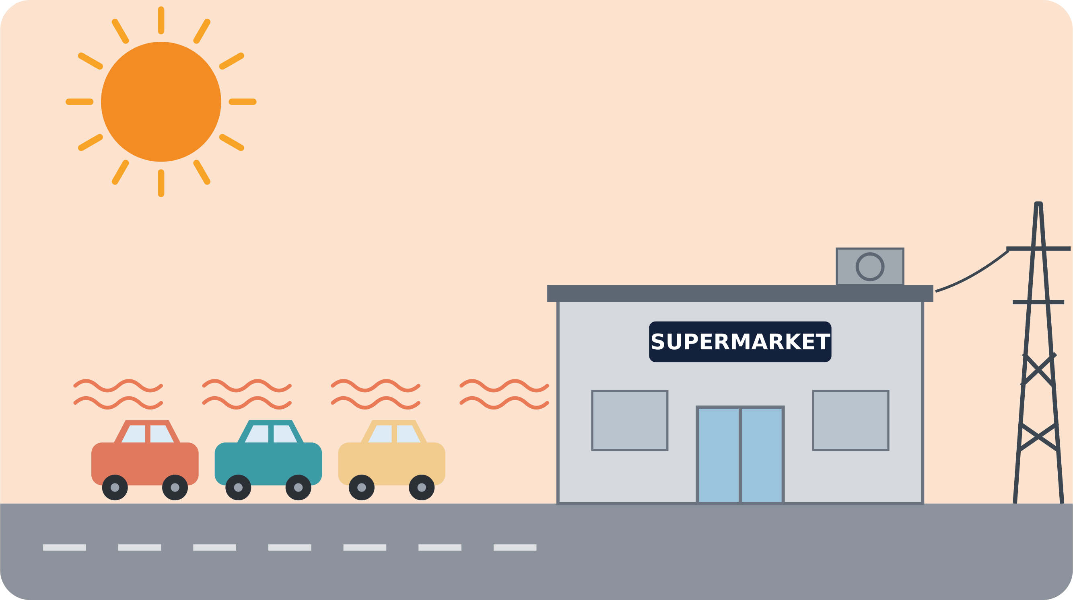
GROUP 5 · SOLAR-POWERED COOLING FOR FOOD & MEDICINE
Sun In,
Cold Out
Rethinking the supermarket
What if this parking lot could keep our food and medicine cold?
Notes:
Hook: point at the hot, empty parking lot. Ask the audience the question and pause for a moment. Then introduce the team and the topic.

Slide 2
Today's supermarket
1
Cooling never stops
Fridges and freezers run 24/7, all year
2
1
2
Power from the grid
Partly still from fossil sources
3
3
Wasted surfaces
Parking lot, roof and facade just heat up
A lot of energy and a lot of space, but they are not working together.
Notes:
Explain today's situation using the three red markers: 1) cooling runs non-stop, 2) the power comes from the grid, 3) large surfaces like the parking lot just heat up in the sun.

Slide 3



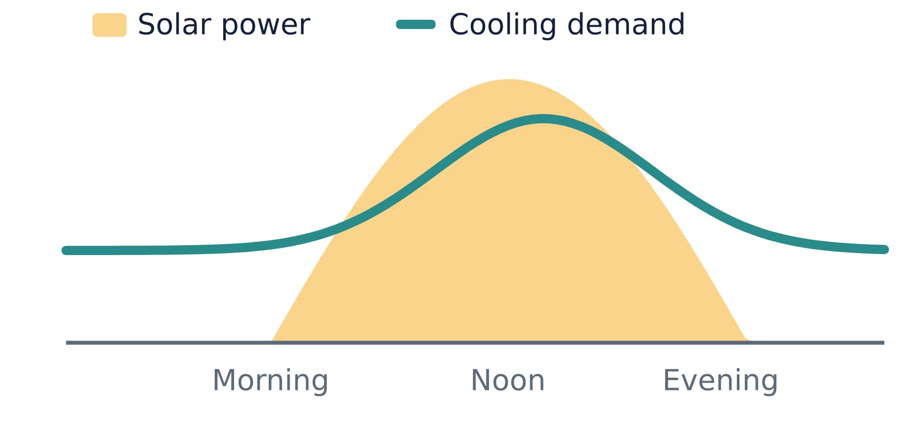
Why cooling matters
Food
Medicine
Hotter summers
Without cold, food spoils and is thrown away
Insulin and vaccines lose their effect when warm
The demand for cooling keeps rising
KEY INSIGHT
The sun shines strongest exactly when we need the most cooling.
Notes:
Food and medicine both depend on reliable cooling, and hotter summers increase the demand. The curve shows the key insight: solar power and cooling demand peak at the same time of day.

Slide 4
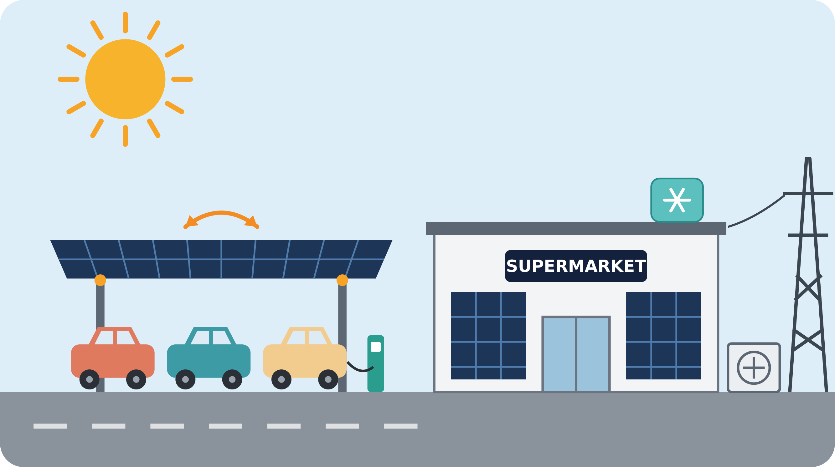
Our idea: the solar supermarket
1
Tracking PV carport
Main power source, follows the sun
4
2
PV facade
The winter booster
1
3
Heat pump
Cools in summer, heats in winter
3
4
Grid connection
2
Backup when the sun is low
Same building, same parking lot, but now it works with the sun.
Notes:
Same sketch as before, now transformed. Walk through the five numbered parts: tracking carport as the main power source, the facade as a winter booster, the heat pump, the cold storage and the grid as backup.

Slide 5








How it works: summer vs. winter
Summer
Winter
Carport delivers lots of solar power
Less sun overall
Surplus is stored as cold, charges EVs or goes to the grid
Facade and tilted carport panels catch the low sun
Heat pump cools the building
Heat pump heats; the grid covers the rest
Notes:
Summer: plenty of solar power, surplus goes into cold storage, EVs or the grid, and the heat pump cools. Winter: less sun, but the facade and tilted carport panels catch the low sun; the heat pump heats and the grid covers the rest.

Slide 6
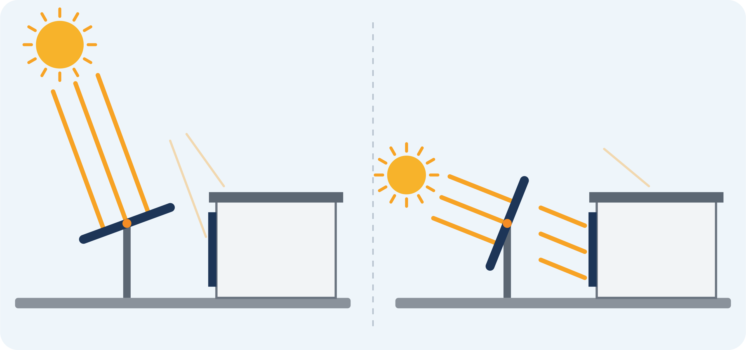

The right angle makes the difference
Tracking carport
Panels tilt to face the sun, all day and all year
PV facade
Low winter sun hits it almost head-on: more own power in winter
Summer: sun high
Winter: sun low
Notes:
Highlight slide. Panels produce the most power when light hits them straight on. The tracking carport tilts to follow the sun. In winter the sun is low, so it hits the vertical facade almost head-on. Result: more of our own power in winter. Optional: demonstrate with a phone flashlight.

Slide 7




Costs & benefits
Costs
PV facade costs about the same as a quality facade, but it produces power
The carport uses space we already have
Tracking adds moving parts and maintenance
Less CO₂
EV charging
Clean power from our own surfaces
For customers and delivery vans
Trade-off: in winter we still need the grid.
Helps stabilize the grid
Safe food & medicine
Stores cold when power is plentiful
Reliable cooling, even on hot days
Notes:
Costs: the facade replaces normal cladding, the carport uses existing space, tracking adds maintenance. Be honest about the trade-off: winter still needs the grid. Benefits: less CO2, EV charging, grid support through flexible cold storage, and safe food and medicine.

Slide 8




Summary & outlook
Today: fights the sun
Tomorrow: uses the sun
NEXT:
Hospitals & pharmacies
Logistics centers
Hot countries, weak grids
Today's supermarkets fight the sun. Tomorrow's use it.
In summer from above, in winter from the side.
Notes:
Recap the red thread: from today's supermarket that fights the sun to tomorrow's that uses it. Outlook: the idea also fits hospitals, pharmacies, logistics centers and hot countries with weak grids. End with the take-home message and open the discussion.

